Slide 1
Classical & Fuzzy Relations

Slide 2
Cartesian Product
An ordered sequence of r elements in the form (a₁, a₂, a₃, …, a_{r}) is called an ordered tuple.
If r=2, it forms an ordered pair.
For crisp sets A₁, A₂, A₃, …, A_{r}
  (a₁, a₂, a₃, …, a_{r}), where a₁ ∈ A₁, a₂ ∈ A₂ etc. is called the cartesian product A₁× A₂ × A₃ …× A_{r}.
Cartesian product is not the same as arithmetic product.
When all A_{r} are identical, A₁× A₂ × A₃ …× A_{r} can be denoted as A^{r}.

Slide 3
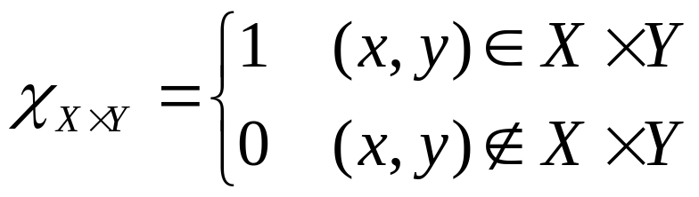
Classical Relations
A subset of the cartesian product of r sets is called a r-ary relation over A₁, A₂, A₃, …, A_{r}.
If r=2, it is a binary relation from A₁ into A₂ ⁽A₁ x A₂⁾.
For a cartesian product of two universe X and Y,
the strength of the relationship between the pairs of elements is measured by a characteristic function χ. If χ=1, it implies complete relationship and χ=0 implies no relationship, i.e.,

Slide 4
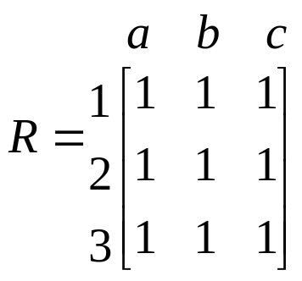
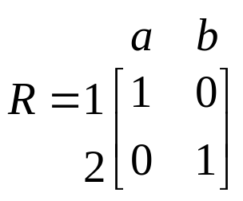
Classical Relations
A binary relationship can be represented by a two dimensional matrix.
1
2
3
a
b
c
This is an example of unconstrained or universal relation
This is an example of constrained or identity relation
1
2
a
b

Slide 5
Cardinality of Crisp Relations
If n elements of set X are related to n elements of set Y, then the cardinality of the relation R between these two sets is the product of the cardinalities of the two sets, i.e., n_{X} * n_{Y}.
Composition of Crisp Relations
Given a relation R between X & Y and
Given a relation S between Y & Z, find
a relation T between X & Z.

Slide 6
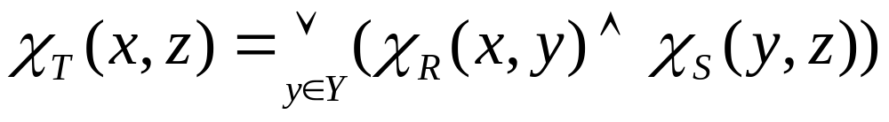
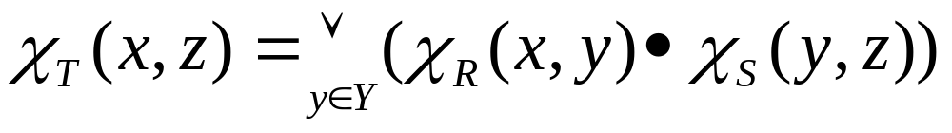
Composition of Crisp Relations
Two forms of composition operations are there.
  Max-min composition, T = R O S
  max-product (max dot) composition, T = R O S

Slide 7
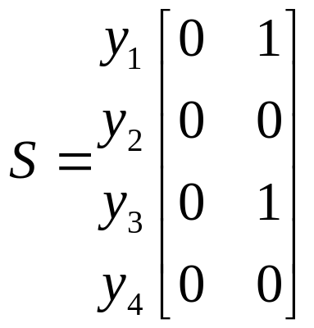
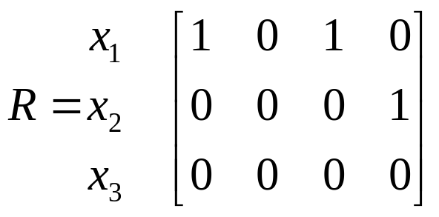
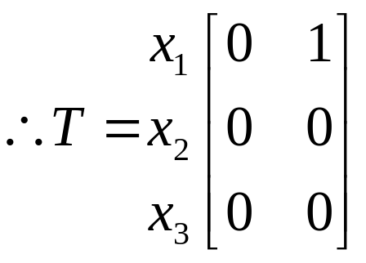
Example
y₁ y₂ y₃ y₄
z₁ z₂
χ_{T} (x₁, z₁) = max[min(1,0), min(0,0), min(1,0), min(0,0)] = 0
χ_{T} (x₁, z₂) = max[min(1,1), min(0,0), min(1,1), min(0,0)] = 1
z₁ z₂

Slide 8
Fuzzy Relations
It is a mapping R from the cartesian product X × Y to the interval [0, 1], where the strength of R is expressed by the membership function of the relation, μ_{R}(x, y).
Let R be a fuzzy relation between two sets X = {Calcutta, Bhuvaneshwar} and Y={Bombay, Pune, Calcutta} representing “very far”. Then R can be represented by
R = 0.8/Calcutta, Bombay + 1.0/Calcutta, Pune + 0.0/Calcutta, Calcutta + 0.7/ Bhuvaneshwar, Bombay + 0.9/ Bhuvaneshwar, Bombay + 0.4/ Bhuvaneshwar, Bombay
Calcutta Bhuvaneshwar
Bombay 0.8 0.7
Pune 1.0 0.9
Calcutta 0.0 0.4
2-D Matrix

Slide 9
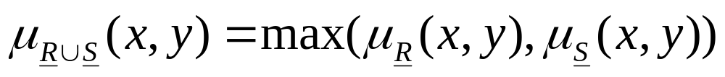
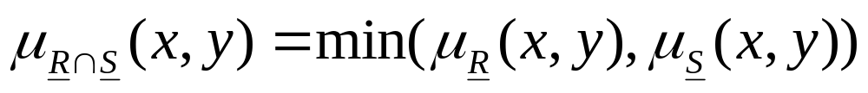
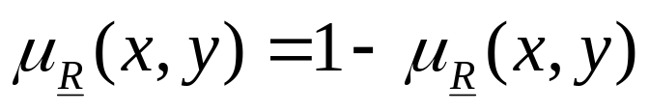
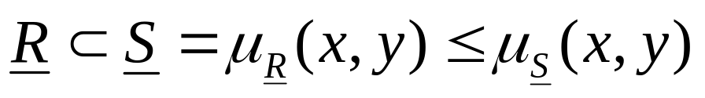
Operations on Fuzzy Relations
It R & S be fuzzy relations for X × Y, the following operations can be applied:
Union
Intersection
Complement
Containment

Slide 10
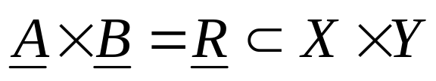
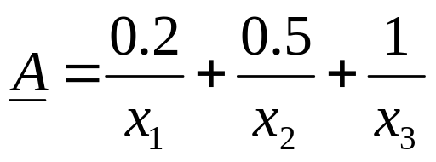
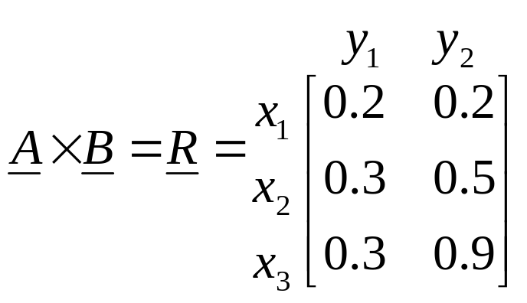
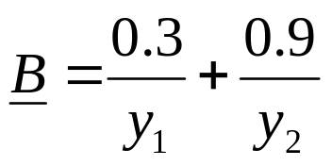
Fuzzy Cartesian Product
For two fuzzy sets A on universe X and B on universe Y, the cartesian product (or relation) R between A and B is given by
Example
If
Then

Slide 11
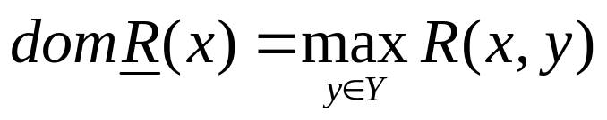
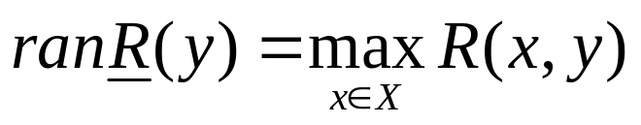
If R (X,Y) is a fuzzy relation Then,
Its Domain is a fuzzy relation on X, whose membership is given by
Each element of X belongs to domain of R to the degree equal to strength of its strongest relation to any member of set Y.
Its Range is a fuzzy relation on X, whose membership is given by
This is the strength of strongest relation which each element of Y has to an element of X.

Slide 12
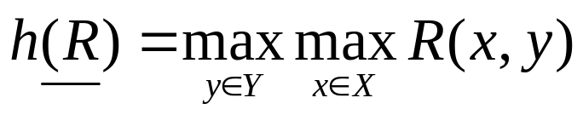
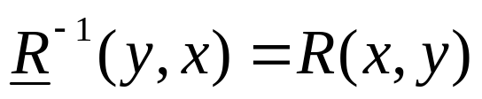
If R (X,Y) is a fuzzy relation Then,
The height of a fuzzy relation R is a number h(R) and is given by
It is the largest membership grade attended by any pair (x,y) in R.
The Inverse of a fuzzy relation R is given by
Is a relation on Y x X.
The Transpose of the matrix R (x, y) is a membership matrix R⁻¹ means ROW of R⁻¹ equals to column of R and vice versa.

Slide 13
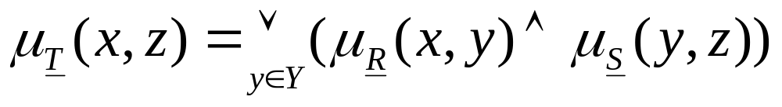
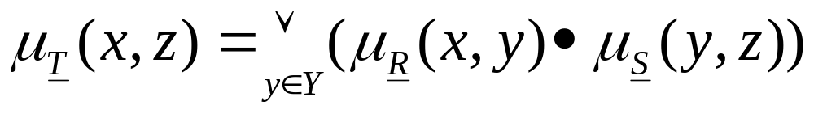
Composition of Fuzzy Relations
Two forms of composition operations are there.
  Max-min composition, T = R O S
  max-product (max dot) composition, T = R O S
  But R O S ≠ S O R

Slide 14
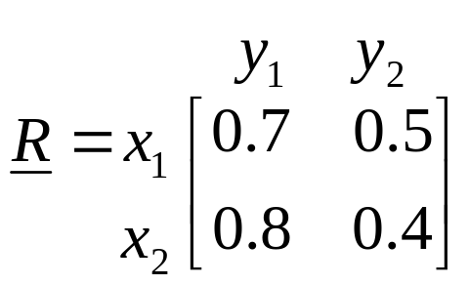
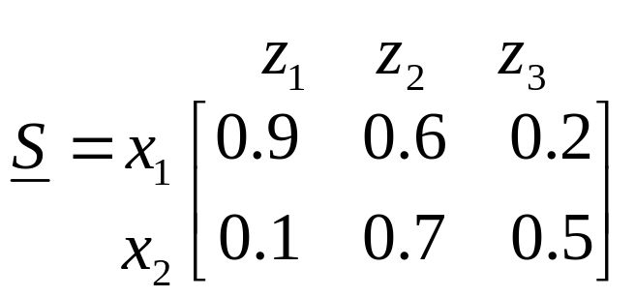
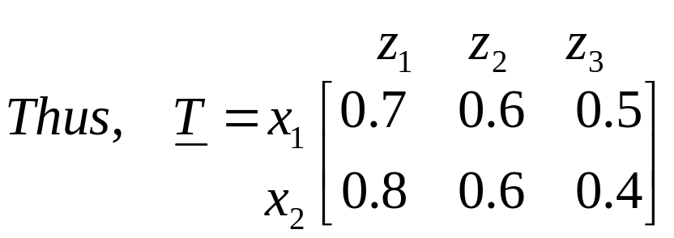
Example (max-min composition)

Slide 15
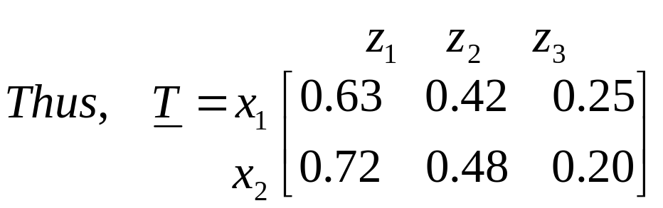
Example (max-dot composition)

Slide 16
Properties of Relations
Any relation can have the properties of reflexivity, symmetry and transitivity.
1
1
1
2
3
2
3
2
3
Reflexivity
Symmetry
Transitivity
There are some more antireflexive, asymmetric and antisymmetric, antitransitive

Slide 17
Crisp Equivalence
Mathematically, a crisp relation R from X to X is an equivalence relation if it possesses all the three properties.
  Reflexivity
    (x_{i}, x_{i}) ∈ R or χ_{R}(x_{i}, x_{i}) = 1
  Symmetry
    (x_{i}, x_{j}) ∈ R implies (x_{j}, x_{i}) ∈ R or χ_{R}(x_{i}, x_{i}) =χ_{R}(x_{j}, x_{i})
  Transitivity
    (x_{i}, x_{i}) ∈ R and (x_{j}, x_{k}) ∈ R implies (x_{i}, x_{k}) ∈ R
    or χ_{R}(x_{i}, x_{j}) andχ_{R}(x_{j}, x_{k}) = 1 implies χ_{R}(x_{i}, x_{k}) = 1

Slide 18
Fuzzy Equivalence or Similarity Relation
  Reflexivity
    μ_{R}(x_{i}, x_{i}) = 1
  Symmetry
    μ_{R}(x_{i}, x_{i}) = μ_{R}(x_{j}, x_{i})
  Transitivity
    μ_{R}(x_{i}, x_{j}) = λ₁ and μ_{R}(x_{j}, x_{k}) = λ₂ implies μ_{R}(x_{i}, x_{k}) = λ
    where λ ≥ min(λ₁, λ₂)
Fuzzy Tolerance/ Proximity
Exhibits only reflexivity and symmetry.

Slide 19
Assignment -1
For each of the binary relation on a single set, state with reason (or prove) whether the relation is reflexive, irreflexive, symmetric, asymmetric, transitive and non transitive.
”is sibling of”
“is parent of”
“is smarter than”
“is the same height as”
“is at least tall as”

